Slide 1
Technology Innovation
Virtual
October 2024 Office Hours

Slide 2
NJEDA provides a suite of financing and incentive products tailored to support NJ’s Startups and grow NJ’s Innovation Economy

Slide 3
Technology Innovation Team
Cecily Kovatch – Managing Director
Clark Smith – Director
Monika Athwal – Manager
Sara Cadeddu – Senior Officer
Christopher Shyers – Senior Officer
Fariha Sheikh – Analyst
Abdelrhman Seliman – Analyst
Syed Fatmi – PT Intern
Notes:
you’ll see here our great team.
And on the right are all of our department’s programs.
We’ll be running through some but not all of these. As not all are as applicable and there’s just not enough time to cover everything.
But if you would like to learn more, each one has its own website and we’re happy to cover them with you individually.
The first program I touch on is the angel investor tax credit

Slide 4
CSIT – R&D grants & vouchers
Angel Investor Tax Credit (ATC) – Refundable tax credit
NJ Entrepreneur Support Program – Guarantee for investors
NJ Accelerate Program – Matching loan and rent benefit
Angel Match – Dilutive direct investment
Technology Business Tax Certificate Transfer (NOL) – Non-dilutive capital
NJ Founders & Funders – Warm intros with investors
M/WBE State Certifications – Information for diverse founders
Products for Technology & Life Sciences Companies

Slide 5
Commission on Science, Innovation, and Technology Mission
Supporting early-stage entrepreneurs / academics developing (R&D) innovation-based companies
Encouraging collaboration and connectivity between industry and academia

Slide 6
Commission on Science, Innovation, and Technology
Grant Programs - www.njeda.gov/csit | Eligibility Requirements (Standard) | Timeline (Target)
Catalyst R&D Voucher - $40K (includes Non-retail food and beverage R&D projects) | < 50 employees 50% of employees work in NJ 1-2 Full-time employees < $5 million in prior yr. revenue In good standing to do business in NJ (Tax Clearance) | Rolling - Open
Catalyst Seed Grant - $75K - $150K | 50% of employees work in NJ | Yearly 2nd Quarter (Est)
Clean Tech R&D Voucher -$40K | 1-2 Full-time employees | Rolling - Open
Clean Tech Seed Grant -$75K | < 5 million in prior yr. revenue | Yearly 4th Quarter (Est)
Clean Tech Pilot Demonstration - $250K | In good standing to do business in NJ (tax clearance) | Yearly 2nd Quarter (Est)
Food / Agriculture Seed Grant - $75K |  | Yearly 2nd Quarter (Est)
Maternal / Infant Health Seed Grant - $75K |  | Yearly 2nd Quarter (Est)
SBIR/STTR Matching Grant - $25K - $50K |  | Rolling - Open

Slide 7
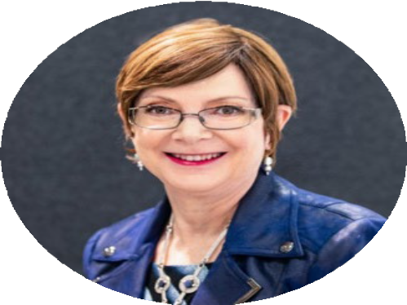
Grant submission assistance for Federal SBIR/STTR - NJSBDC -https://njsbdc.com/techteam/
Information on capabilities at NJ universities:
www.researchwithnj.com
JUDITH SHEFT
Executive Director - CSIT
Jsheft@njcsit.gov

Slide 8
Angel Investor Tax Credit
NJEDA provides refundable tax credits to private investors in eligible NJ technology/biotechnology companies.
20% tax credit; 5% bonus based on diversity/location
Full-time employees (FTE)
at least 1, no more than 225
75% of all employees working in New Jersey
Must be commercializing an eligible technology
Investment must be a non-refundable transfer of cash
Fully submitted application within 6 months of investment
www.njeda.gov/angeltaxcredit/

Slide 9
Angel Tax Credit Approved Company
Princeton Identity
Cybersecurity software company
Secured angel funding through participation in Golden Seeds
The funding from GS and other investors was matched by the NJEDA's Angel Match Program with a $500,000 investment
The company’s investors leveraged Angel Tax Credit as well

Slide 10
NJ Entrepreneur Support Program
Provides a guarantee of up to 80% on private investor loans/convertible notes advanced to eligible NJ Companies for working capital.
Company
Note/Loan terms
Maturity of at least 1 year
No payments in year 1
Unsecured
Guarantee terms
80% Note/Loan Amount
Up to $400K
1 year from date of note
No Revenue Requirement
At least 1 C-suite working in NJ
50% of employees in NJ supported by docs
NJ Office(co-working, incubator, leased)
www.njeda.gov/njesp/

Slide 11
NJESP Approved Companies

Slide 12
NJ Accelerate
Inclusive Ventures Lab﻿
New York City﻿
Boston﻿
Newark﻿
ASPIRE Program﻿
Hadley, MA﻿
New York City﻿
Newark﻿
Boston﻿
New York City﻿
New York City﻿
New York City﻿

Slide 13
NJ Accelerate
Provides support via matching loans and rent grants to graduate companies of Approved Accelerators.
Investment Loan Benefit
Working Capital
Convertible Note Up to $250,000 matching $1:1 investment from Accelerator
10-year maturity, 3% flat, no repayments for 7 years
10-year Warrant equal to 50% of note
5% bonus for NJ–certified MBE/WBE businesses
Eligibility Requirements
50% FT Employees & 2 Founders/C-Suite Executive working in NJ
Graduate of an Approved Accelerator
Rent Support Benefit
Up to 6-month grant at an approved NJ Accelerate coworking space, up to $25,000
NJ–certified MBE/WBE businesses may be eligible for a bonus month
https://www.njeda.gov/njaccelerate/

Slide 14
Angel Match Program
NJEDA matches preferred equity investment in early-stage, product-based technology companies, with a direct investment up to $500,000.
Note terms
10-year, 3% interest rate
No payments for first 7 years, no prepayment penalty
10-year Warrant equal to 50% of note
Angels & Funds eligible – min of 2 investors, preferred equity
Product based sales revenue – Min $100K
50% FT Employees & 2 Founders working in NJ
NJ Office (co-working, incubator or leased)
www.njeda.gov/AngelMatch/

Slide 15
Angel Match Approved Companies

Slide 16
Technology Business Tax Certificate Transfer (NOL)
Enables emerging companies running at an operating loss to sell a percentage of accrued losses to unrelated corporations as a tax credit.
Protected Proprietary Intellectual Property
Technology or Biotechnology
At least 1/5/10 NJ FTE (but no PA)
No more than 224 FTE (in the US)
2 Consecutive years of operating losses
Eligibility must be met at time of application and closing
Applications open annually
May-June
www.njeda.gov/nol/

Slide 17
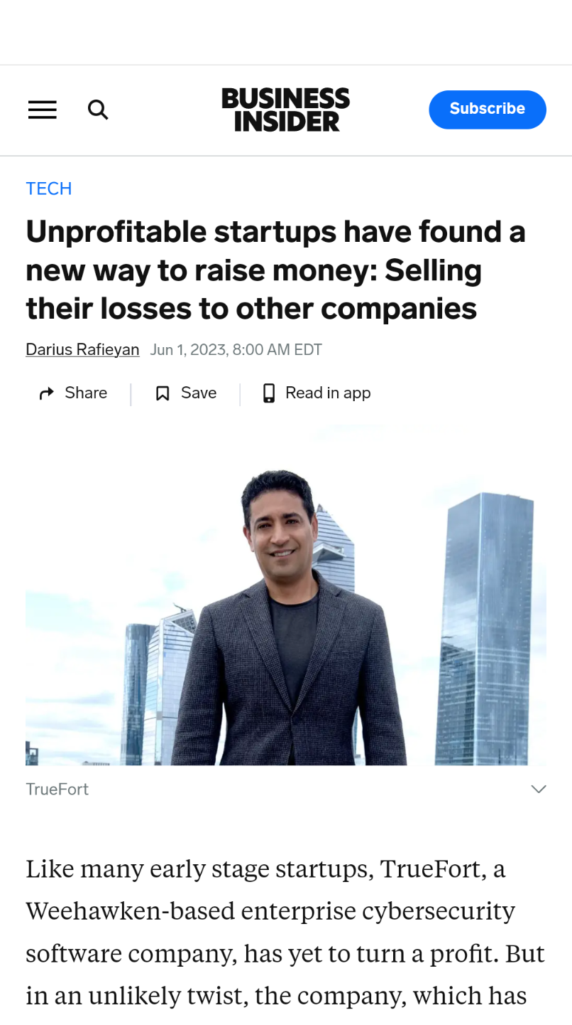
NOL Approved Company
TrueFort, Inc.
Cybersecurity software company
Headquartered in Weehawken
28 high-skilled & high-paying jobs
Sameer Malhotra CEO & Founder “with tech valuations down and volatile markets, the venture capital industry has seized up…This year, in particular, having access to the program was a fantastic lifeline to us... programs like this are a compelling reason to stay in the Garden State."
- Business Insider, June 2023

Slide 18
NJ Founders and Funders
NJEDA facilitates warm introductions between companies and investors via an event twice a year
Companies can pitch via 10-minute 1-1 meetings during the event
Over 90% of those participants secured additional meetings with at least one investor
Curtis Lee
Manager Venture Engagement - Venture Products
NJInvestments@njeda.gov
www.njeda.gov/founders-and-funders/

Slide 19
NJEDA Diversity and Inclusion Unit
Jermaine Pharmes
Director Business Diversity/Development
Jermaine.Pharmes@njeda.gov
NJEDA Diversity & Inclusion Unit supports the Authority’s commitment to growing New Jersey’s economy and increasing equitable access to opportunity.
The NJEDA believes that diversity, equity, and inclusion are inherent to creating a stronger and fairer New Jersey economy and building a diverse workforce increases business performance. The Authority is guided by the concept of “diversity on purpose,” the idea that diversity at the NJEDA and in the businesses and communities the Authority serves should not only be recognized but intentionally fostered. This principle drives the NJEDA to produce innovative programs and services that best serve New Jersey’s diverse residents, communities, and businesses.
Minority/Women Business Enterprise (M/WBE)
www.business.nj.gov/pages/certifications/

Slide 20
Innovation Office Hours
Companies learn about NJEDA products developed to support tech and biotech startups.
At each event, there will be a brief presentation, featured guest speakers, and time for networking.
Monthly office hours
Rotating virtual and in-person
In-Person: North Brunswick and Newark
Next: North Brunswick November 15th, 2pm-4pm
www.njeda.gov/innovation-office-hours/

Slide 21
Let’s Connect!
Innovation Mailbox
Innovation@njeda.gov
@NewJerseyEDA

