Slide 1
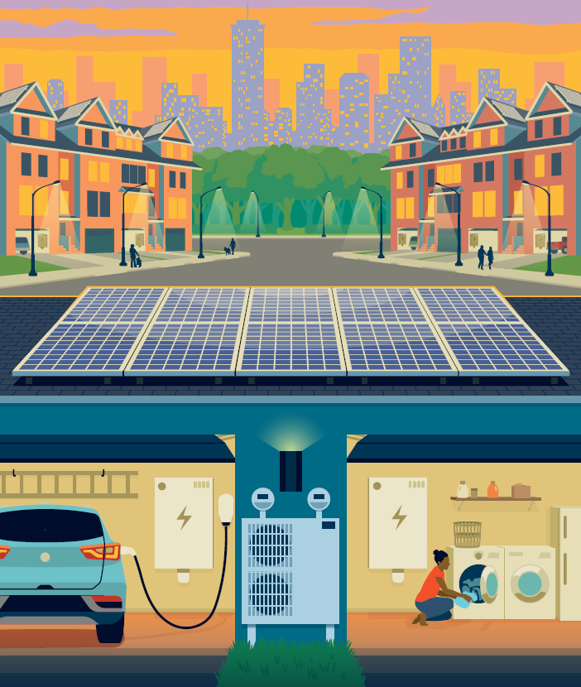
Clean Energy Products

Slide 2
Clean Energy Products

Slide 3
Product Spotlight:
Reducing on-site operating greenhouse gas emissions from existing buildings

Slide 4
NJ Cool Program at a Glance
Visit www.njeda.gov/njcool for more information
Reimburse applicants at 50% rate for eligible hard construction costs (labor, equipment, & materials) for retrofit projects in existing commercial, industrial, & institutional buildings that reduce operating greenhouse gas emissions
Project Grants
Up to $1,000,000
Key Facts
Program Benefits
$15M grant program funded by RGGI
Limited geography pilot, only existing buildings in Newark, Edison, and Atlantic City ($5M set-aside per community until 04/22/25)
Support projects that reduce emissions through fuel switching, high GWP refrigerant replacement, energy efficiency improvements, and on-site renewables
Grant awards of $50,000 to $1 million to building owners/tenants for eligible construction costs
State Prevailing Wage & Affirmative Action compliance required for all construction work
Reduce costs of capital improvement projects for commercial building owners/tenants
Reduce building operating greenhouse gas emissions
Improve air quality
Reduce building energy costs
Accelerate the adoption of building decarbonization systems, technologies, and construction practices within NJ
Stackable with most State Utility/BPU incentives

Slide 5
Eligible Project Scope
What scope does my building project need to include to qualify for an NJ Cool grant?​
A. Fuel Switching: Switching >75% of building space heating load from fossil fuel-based combustion heating systems to non-combustion based systems
and/or​
B. Refrigerant Replacement: Replacing >75% of existing building high global warming potential (GWP) refrigerants (700+ GWP) with lower GWP alternatives​

Slide 6
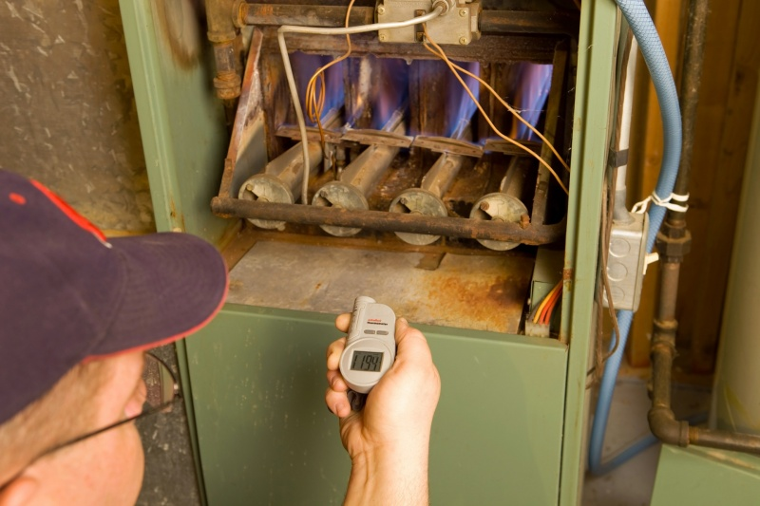
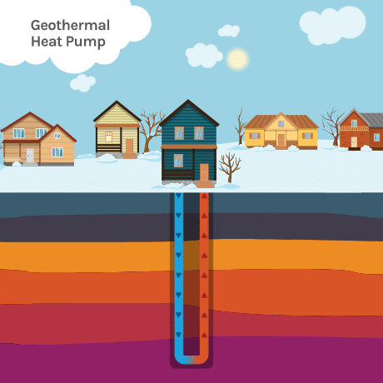
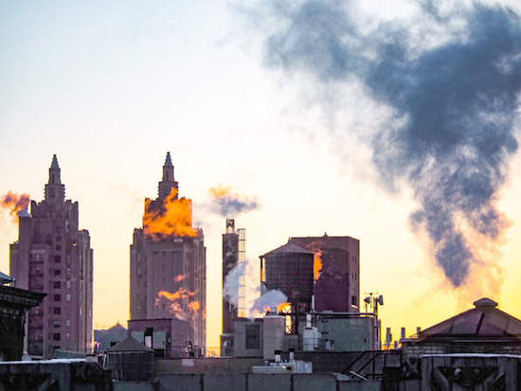
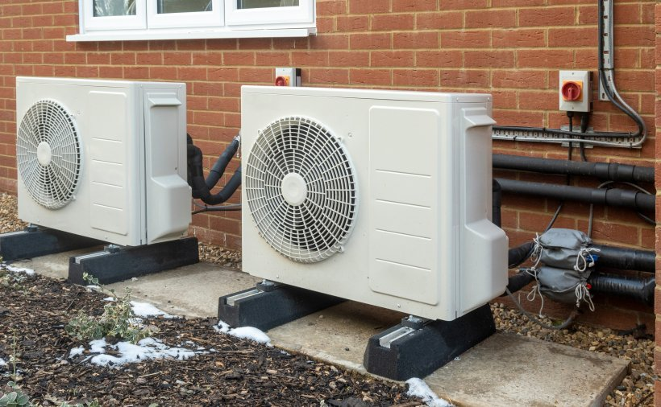
A. What does fuel switching mean?

Slide 7
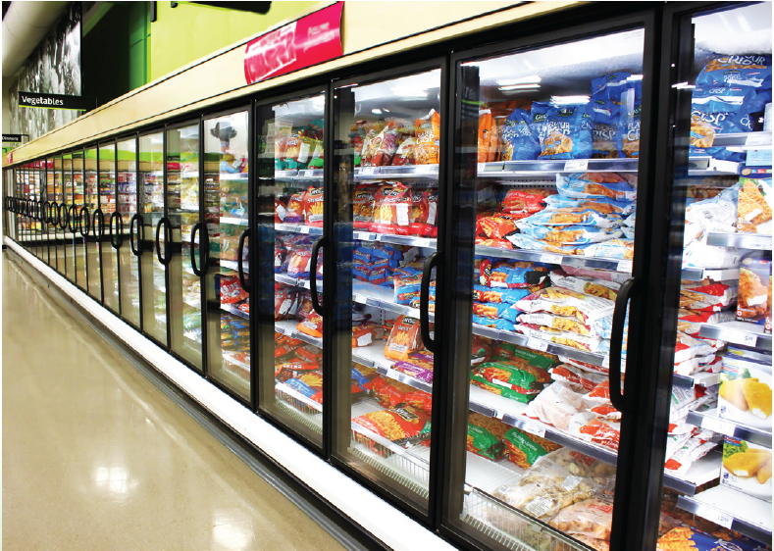
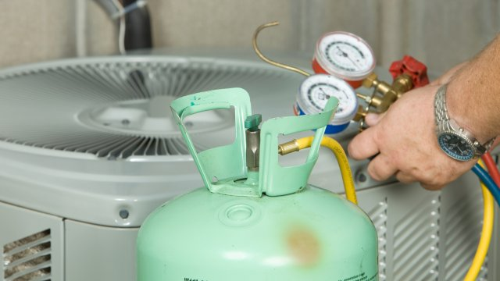
B. What is refrigerant replacement?

Slide 8
Eligible Project Scope
Once items A and/or B are included, grant funding can also be used for additional work that further reduces operating emissions or improves energy efficiency of the building, such as: ​
Installing on-site renewable energy generation (solar) or energy storage systems​ (batteries)
Replacing natural gas-powered appliances (e.g.: hot water heaters, clothes dryers, etc.) with electric powered alternatives​
Installing building management systems (BMS) or energy load controls​
Conducting weatherization or building envelope (e.g.: façade, windows, insulation) upgrades​
Installing heat recovery equipment​
Replacing lighting with more efficient equipment or controls​

Slide 9
Eligible Applicants
Building owner (or tenant with owner approval) applies to program
Only retrofits of existing buildings, not new construction or enlargements/additions
Building must be located within a pilot municipality (Newark, Edison, Atlantic City)
Construction work must be completed by Publics Work contractor(s) registered with NJDOL complying with State prevailing wage and affirmative action requirements
Commercial, industrial, or institutional building use is defined by select NJ Building Code Occupancy Classes or NJ Admin Code Property Classes

Slide 10
Eligible Occupancy Classes + Building Code Examples
Retail or wholesale stores
Department Stores
Drug Stores
Markets
Gas Stations
Sales rooms
Mercantile Group M
Assembly Group A-2
Restaurants and dining facilities
Bars and nightclubs
Banquet halls
Casinos (gaming areas)
Business Group B
Animal hospitals, kennels, and pounds
Ambulatory care facilities
Banks
Barber and beauty shops
Car wash
Clinics (outpatient)
Dry cleaning and laundries
Food processing/commercial kitchens < 2,500 sq ft
Motor vehicle showrooms
Print shops
Professional services (office buildings)
Radio and television stations
Training and skill development (e.g.: martial arts studios, non-academic)
Laboratories: testing and research

Slide 11
Eligible Property Classes + Examples
Class 4A: Commercial Property
Shopping centers
Malls
Office buildings
Restaurants
Theaters
Nursing homes
Class 4B: Industrial Property
Factories
Laundry Facility
Manufacturing Plant
Dry Cleaners
Storage warehouses
Class 15A: Public School Property
Property owned by Federal, State, county, or local governments, or their agencies used for public education
Class 15B: Other School Property
Property owned by non-governmental, non-profit corporation used for educational purposes
Class 15C: Public Property
Property owned by Federal, State, county, or local governments, or their agencies devoted to public use
Class 15D: Church and Charitable Property
Property owned by religious and charitable organizations used in the work of the organizations
Class 15E: Cemeteries and Graveyards
Property solely devoted to or held for use as a cemetery, graveyard, or burial ground
Class 15F: Other Exempt
Property exempt from taxation but not described in any of the foregoing classes

Slide 12
Eligible Project Costs
Materials, labor, and/or equipment that are directly related to emissions reductions or energy efficiency improvements
Enabling work necessary for proposed emissions reducing/energy efficient building systems to be operational
For example: upgrading electric panels or making roof structural improvements for new rooftop solar or HVAC systems

Slide 13
NJ Cool Application Process
Applications are now open for property owners/tenants, first-come first-served!
Property ownership/lease information
Proof of eligible building occupancy or property class
Project details including cost estimates
Estimates of emissions/energy reduction prepared by qualified professional
www.njeda.gov/njcool/
njcool@njeda.gov

Slide 14
Thank you!
Sean Sonnemann sean.sonnemann@njeda.gov njcool@njeda.gov
https://www.njeda.gov/

